Slide 1
Computer Peripherals
CSE 315: Peripheral & Interfacing

Slide 2
Discussion Materials:
Storage Devices
Hard Disk Drive
Flash Memory (PD & MC)
I/O Devices
Displays (LCD, LED)
Printers (DMP, IJP & LP)
Scanners
Pointing Devices

Slide 3
Peripheral
Devices that are external to the main processing function of the computer
Other than the CPU, memory, power supply
Classified as input, output, and storage
Connected via
Ports like
Serial, Parallel, USB etc
Interface to systems bus like
Small Computer System Interface (SCSI), Integrated Drive Electronics (IDE), Personal Computer Memory Card International Association (PCMCIA)

Slide 4
SCSI (Small Computer System Interface )
Small Computer System Interface (SCSI) is a set of standards for physically connecting and transferring data between computers and peripheral devices. The SCSI standards define commands, protocols, electrical, optical and logical interfaces. SCSI is most commonly used for hard disk drives and tape drives, but it can connect a wide range of other devices, including scanners and CD drives, although not all controllers can handle all devices. The SCSI standard defines command sets for specific peripheral device types; the presence of "unknown" as one of these types means that in theory it can be used as an interface to almost any device, but the standard is highly pragmatic and addressed toward commercial requirements.

Slide 5
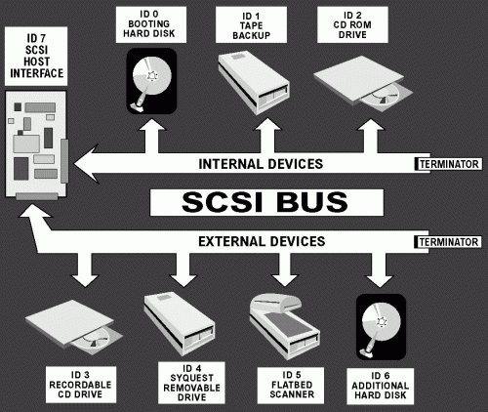
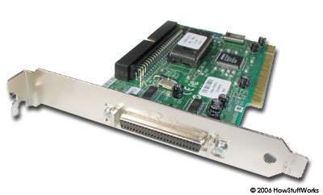
SCSI (contd.)

Slide 6
IDE (Integrated Drive Electronics)
Nominally called the IDE (Integrated Drive Electronics) bus; how ever it's more correctly known as the ATA (Advanced Technology Attachment) specification [ATA Bus]. The IDE bus is used in Personal Computers [PCs] as a hard-drive or peripheral bus to interconnect the PC mother board and a hard drive. The IDE bus is a Parallel bus. With the introduction of the Serial ATA [SATA] specification Parallel ATA [IDE] is now being called PATA.
The specification has been up-graded a number of times each building on the past specification. ATA-1 and 2 were single documents, but like SCSI, after ATA-2 the specification was divided into a number of different documents. Most maintain backward compatibility, keeping in mind the cable changed. Each new version of the standard produced an increase in bus speed. The data transfer rate is shown after each version listed below. The maximum IDE bus speed is 133MBytes/sec [133MBps].

Slide 7
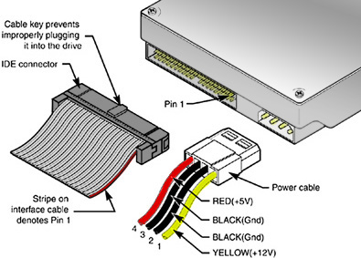
IDE (contd.)

Slide 8
PCMCIA (Personal Computer Memory Card International Association )
In computing, PC Card is a configuration for computer parallel communication peripheral interface, designed for laptop computers. Originally introduced as PCMCIA, the PC Card standard as well as its successors like CardBus were defined and developed by the Personal Computer Memory Card International Association (PCMCIA).

Slide 9
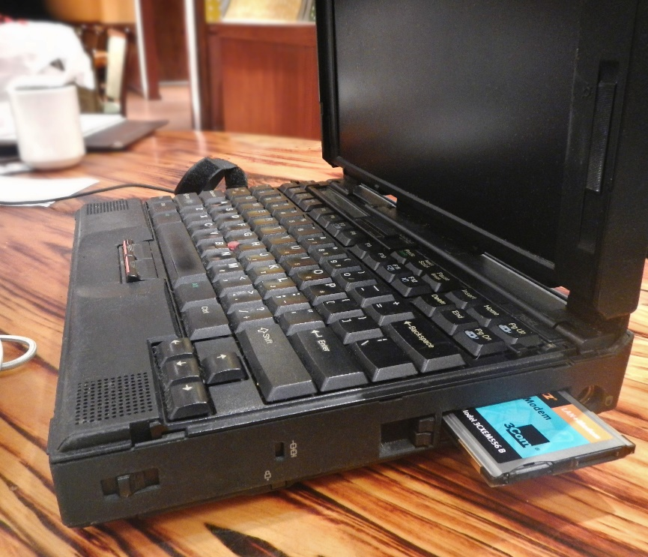
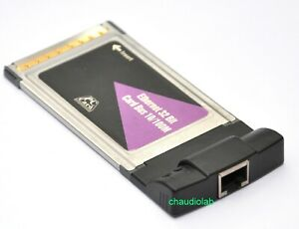
PCMCIA (contd.)

Slide 10
Interfacing
An interface is the point of interaction with software, or computer hardware, or with peripheral devices
There are two types of interfaces:
1. Hardware Interfaces.
2. Software Interfaces.

Slide 11
Interfacing Contd.
HARDWARE INTERFACES: Hardware interfaces exist in computing systems between many of the components such as the various buses, storage devices, other I/O devices, etc.
SOFTWARE INTERFACES: A software interface may refer to a range of different types of interface at different levels.

Slide 12
Interfacing Contd.
Different levels of software interfacing.
An operating system may interface with pieces of hardware.
Applications or programs running on the operating system may need to interact via streams
In object oriented programs, objects within an application may need to interact via methods.

Slide 13
Ports
A port serves as an interface between the computer and other computers or peripheral devices
Primarily there are two types of ports:
Physical Ports
Virtual Ports

Slide 14
Physical Ports:
Physical ports are used for connecting a computer trough a cable and a socket to a peripheral device.
Physical computer ports list includes:
a. Serial ports (DB9 socket)
b. USB ports (USB 2.0 or 3.0 socket / connector)
c. Parallel ports (DB25 socket / connector

Slide 15
Virtual Ports
Virtual ports are data gates that allow software application (network) to use hardware resources without any interference.
This computer ports (network ports) are defined by IANA (Internet Assigned Numbers Authority).
Used by TCP ( Transmission Control Protocol ), UDP ( User Datagram Protocol ), DCCP ( Datagram Congestion Control Protocol ) and SCTP ( Stream Control Transmission Protocol )

Slide 16
Storage Devices: Terminology
Medium
The technology or product type that holds the data
Access Time
The time to locate data and read it
Calculated as an average in seconds e.g. - s, ms, µs, ns, etc
Transfer Rate
Amount of data moves per second
Calculated in bytes/second e.g. – KBPS, MBPS etc

Slide 17
Storage Devices: Primary
Primary memory
Named as cache or conventional memory
Has an immediate access by the CPU
Expanded storage
RAM – Random Access Memory
A buffer between cache memory and secondary memory

Slide 18
Storage Devices: Secondary
Secondary storage
Permanent memory
Non volatile memory
Data and programs must be copied to primary memory for CPU access
Electro-Mechanical devices
Direct access storage devices (DASDs)
Online storage
Offline storage – loaded when needed

Slide 19
Storage Devices: Hierarchy
 | Devices | Access Time | Transfer rate
Primary storage | CPU registers | - | -
 | Cache memory | 15-30 ns | -
 | Conventional memory | 50-100 ns | -
 | Expanded memory | 75-500 ns | -
Secondary storage | Hard disk | 10-50 ms | 600-6000 Kbytes/s
 | Floppy disk | 95 ms | 100-200 Kbytes/s
 | CD-ROM | 100-600 ms | 150-1000 Kbytes/s
 | Tape | 0.5+ s | 200-3000 Kbytes/s

Slide 20
Storage Devices: Technology
Primary storage
Semiconductor technology e.g.- RAM
Volatile i.e. contents are depended on power
Secondary storage
Magnetic technology e.g. Hard Disk Drives
Non-volatile i.e. contents are not depended on power

Slide 21
Storage Devices: Intervention
Online storage
Storage that is accessible to programs without human intervention
Primary & Secondary storages are online
Example- RAM, HDD etc
Offline storage
Storage that is not accessible to programs without human intervention
Sometimes called archival storage
Example- CD, DVD, External HDD etc

Slide 22
Assignment for next class:
Serial port, Parallel port, USB 10
Relation between peripheral and interfacing 10
Due date: Next lecture day

Slide 23
Thank you

